Slide 1
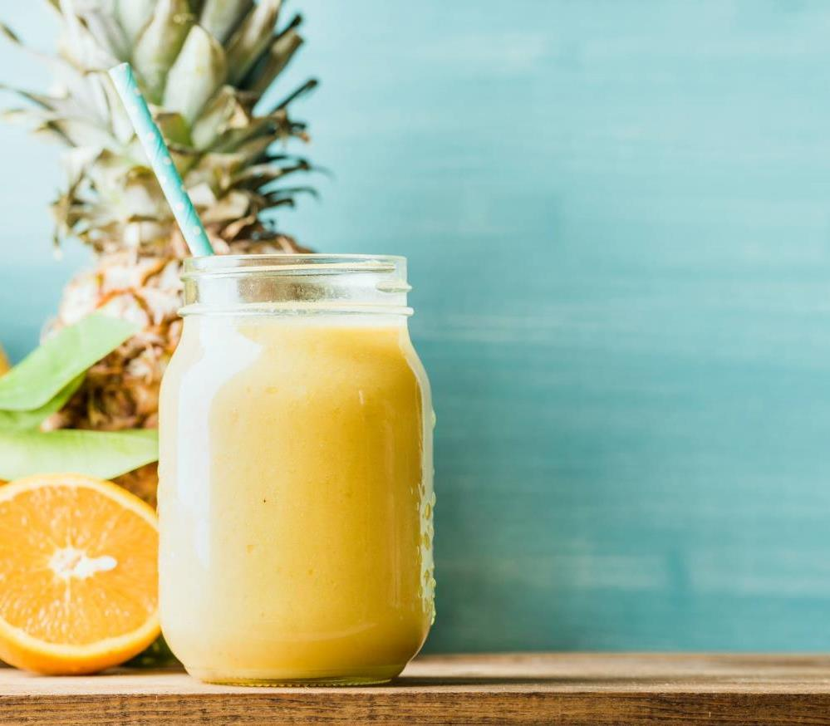
Growing Success: The FreshFruit Company Story
Sophia Patel

Slide 2
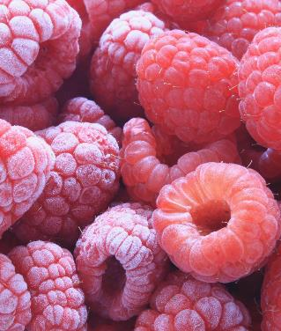
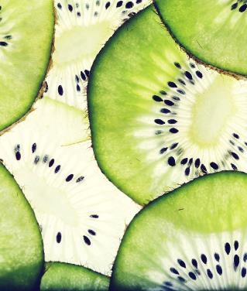
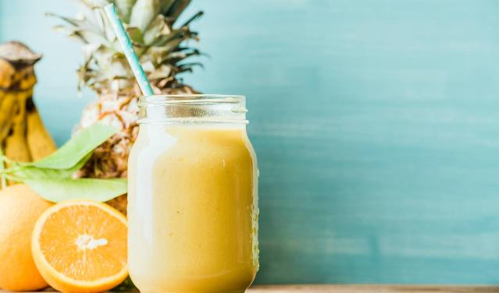
Agenda
Introduction
Products
Our team
Timeline
Future Plans
Conclusion

Slide 3
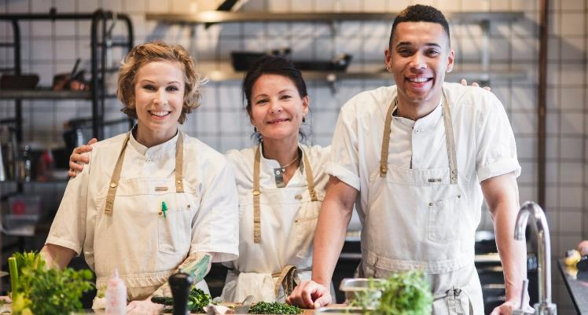
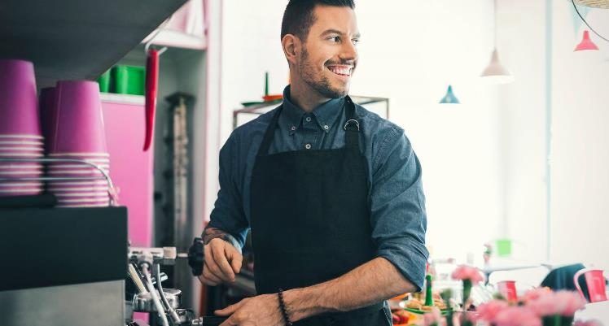
Introduction
Today, we'll take a closer look at our mission, product offerings, market analysis, sales trends, and future plans for growth. We hope to inspire you with our story and our commitment to sustainability and quality. Thank you for joining us.

Slide 4
Our Products

Slide 5
Fruitful Fields products
At Fruitful Fields, we take great pride in our high-quality fruit. We work closely with local farmers to source the freshest and most delicious produce available. Our products include a wide variety of fruits, such as apples, bananas, berries, cherries, grapes, mangoes, oranges, and more.
Apples
Bananas
Berries (strawberries, blueberries, raspberries, etc.)
Cherries
Grapes
Mangoes
Oranges
Pineapples

Slide 6
"From our orchards to your table, Fruitful Fields is committed to providing the freshest and most delicious fruit possible."

Slide 7
Our Team
David Lee
Maria Perez
Rachel Chen
John Kim
Sales Manager
Marketing Coordinator
Operations Manager
Customer Service Representative

Slide 8
Timeline
The company launches a line of value-added fruit products, such as pre-cut fruit cups and fruit-based snacks, to provide customers with convenient and healthy snacking options.
Fruitful Fields continues to expand its operations, partnering with more local farmers and opening additional retail locations in new markets across the country.
Fruitful Fields is founded by a group of farmers who share a passion for delivering high-quality, fresh fruit to customers.
2007
2015
2005
2010
2023
Fruitful Fields expands its operations to include organic and fair-trade fruit options, in response to growing demand for sustainably-produced produce.
Fruitful Fields opens its first brick-and-mortar retail store, offering a wide selection of fresh fruit and value-added products to customers in the local community.

Slide 9
Future Plan
Expand our operations
Increase our product offerings
Expand our operations to include more regions and countries to serve a wider customer base.
Continue to prioritize sustainable farming practices and explore new ways to reduce our environmental impact.
Increase our product offerings to include more exotic and rare fruits from around the world.
Develop new packaging and logistics solutions to improve the freshness and quality of our fruit during transport and storage.

Slide 10
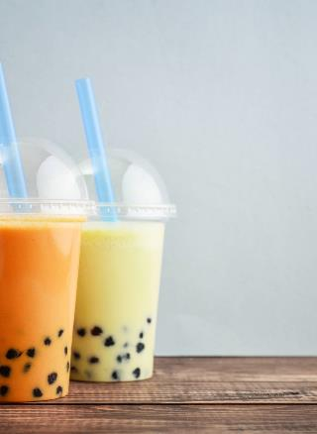
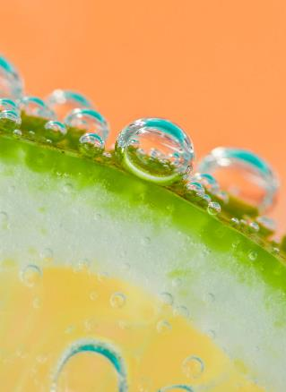
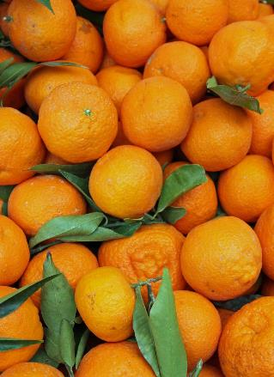
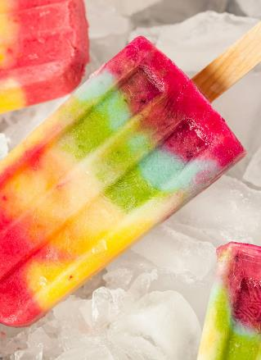
Summary
Fruitful Fields is a company that is committed to delivering high-quality, fresh fruit to our customers. We pride ourselves on our sustainability efforts and our dedication to ethical business practices. We are constantly looking for ways to innovate and improve, from expanding our product offerings to investing in new technologies.

Slide 11
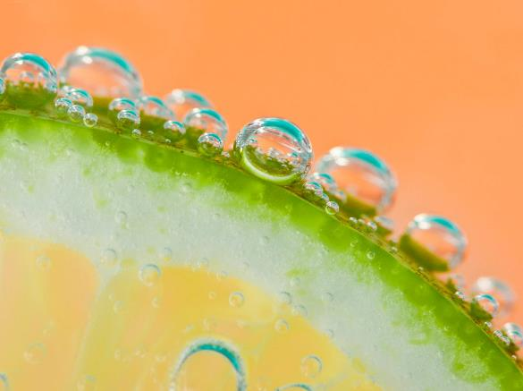
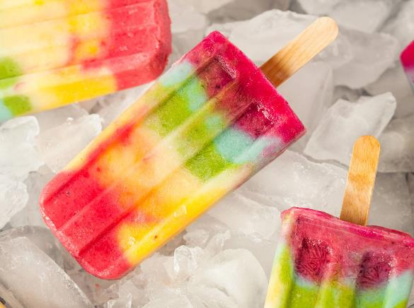
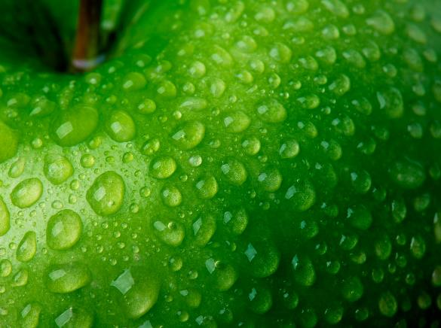
Thank you
Sophia Patel
(210) 346-2318
Sophia Patel@fruitfulfields.com

